Slide 1


ArcGIS API for JavaScript: Web Editing in 2D
Jose Banuelos
Heather Gonzago
2022 ESRI DEVELOPER SUMMIT
Notes:
2022 Esri Developer Summit

Slide 2

Agenda
Topics covered in this presentation
Web editing
What is it and how does it work?
Editing widgets
Editor
FeatureForm
FeatureTemplates
Sketch/SketchViewModel
etc.
Form work
Sketching/editing

Slide 3
Enable editing on a feature service
The feature service must be enabled for editing
Constraints are set at the service level
Client apps, i.e. the JavaScript API, cannot override any permissions set on the service
Client API accesses REST API calls

Slide 4
JavaScript API editing basics
Granular API
Using ApplyEdits directly off the FeatureLayer
Configurable widgets
Encapsulates granular functionality
Easy to use as-is
Configurable
Two parts, view UI (ie. widget), and its underlying logic (ie. viewModel)

Slide 5
Configurable widgets
FeatureTable
FeatureForm
FeatureTemplates
SketchViewModel
Editor
New at 4.23
SnappingControls
Attachments

Slide 6
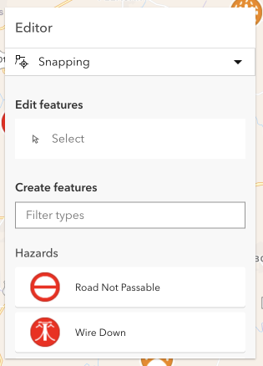
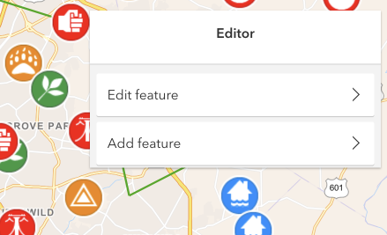
4.23 Editor had a make over
Editor refactored at 4.23
One initial panel that consolidates both the create and update workflows.
Continuous (batch) editing for create workflow
Integrated snapping controls UI
Additional Editor updates expected in future releases

Slide 7

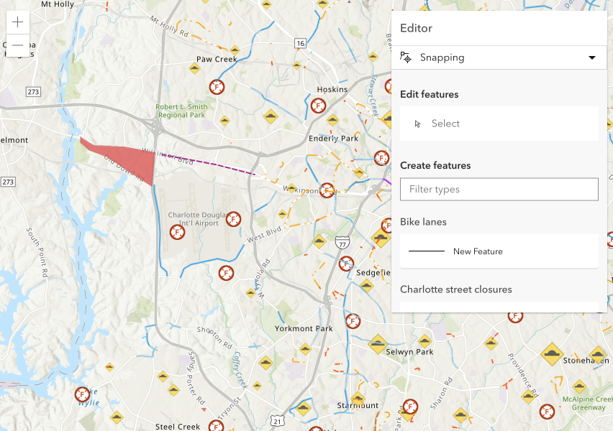
Editor
Widget used as-is (ie. no configuration)

Slide 8

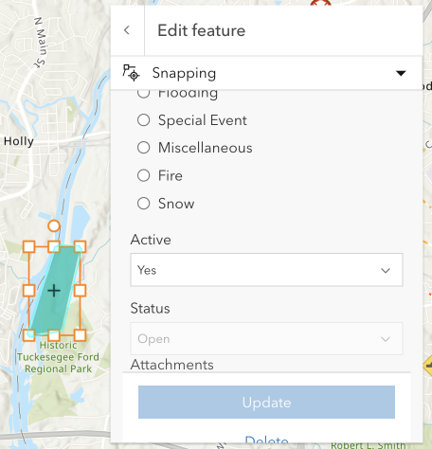
Granular control for editing
LayerInfos for layer-specific editing permissions
FormTemplate provides granular control
Field type
Grouped or ungrouped
Descriptive text
Hint
Description
Input types
Field expressions

Slide 9
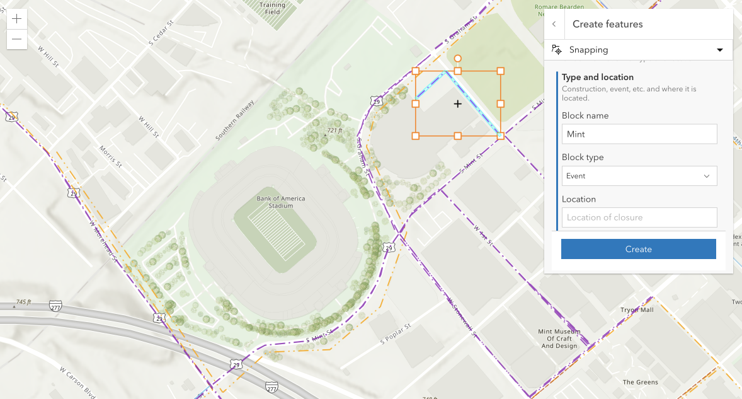
Editor
Configured

Slide 10
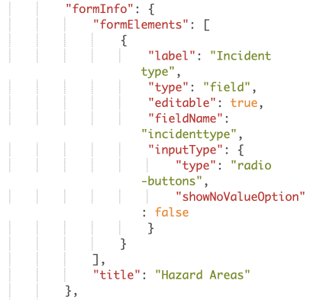
Webmap forms
FormInfo is saved within the webmap
Author form content online
Consume form’s info without a lot of code

Slide 11
Editor
WebMap form updates

Slide 12

Sketch
Jose Banuelos

Slide 13
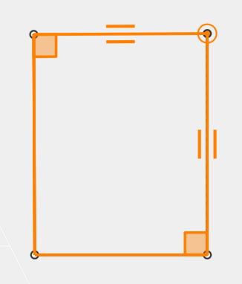
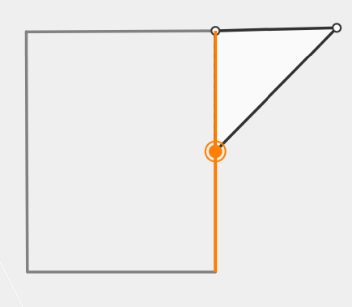
Snapping (self and feature)
Self snapping (geometry guides)
Feature snapping

Slide 14
Snapping (continued…)
FeatureSnappingLayerSource
The layers we want to snap to with feature snapping
Layer type support
FeatureLayer
GraphicsLayer
CSVLayer
GeoJSONLayer
WFSLayer

Slide 15
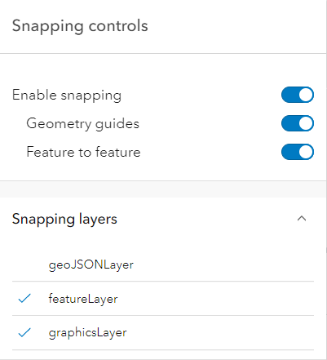
Snapping (continued…)
SnappingOptions
Class used to configure snapping for editing and drawing workflows
Editor, Sketch, SketchViewModel, SnappingControls
SnappingControls
Widget created to handle SnappingOptions props via a user interface
Embedded in Editor and Sketch

Slide 16
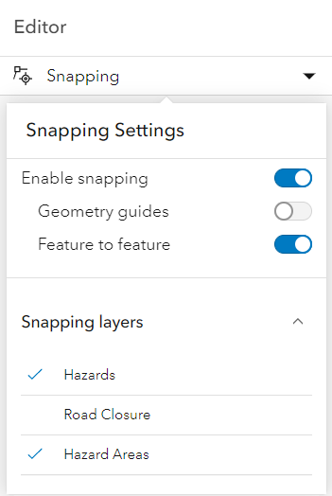
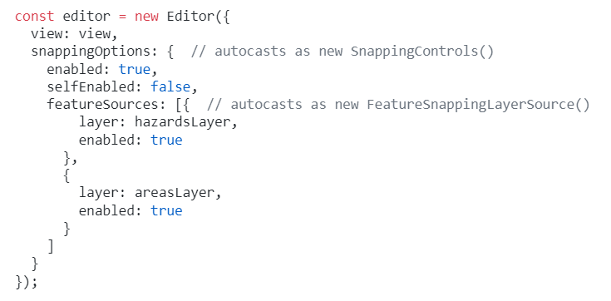
Snapping (Let us show some code)
SnappingOptions
enabled
selfEnabled
featureEnabled
featureSources

Slide 17
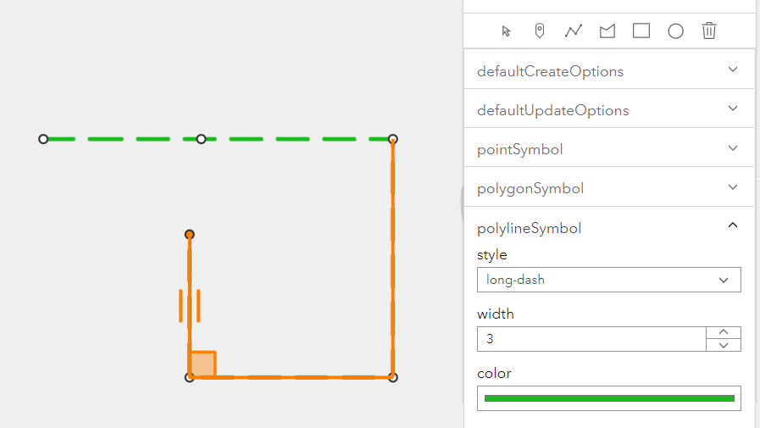
Snapping with SketchViewModel and SnappingControls
Live Demo

Slide 18
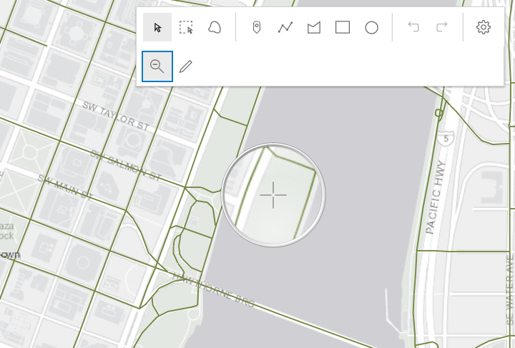
Custom Sketch tools
Live Demo

Slide 19
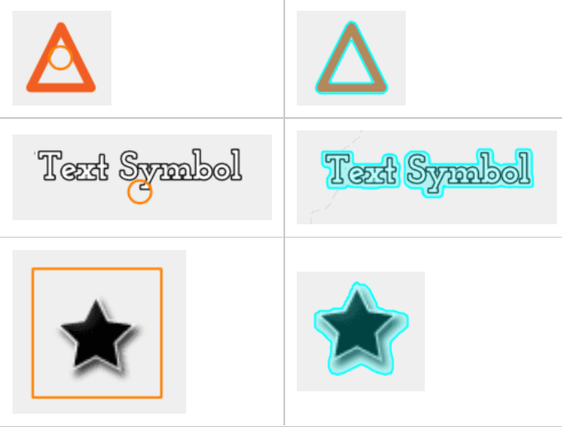
Sketch & Editor: Improvements to selection and highlight
HitTest improvements in the API led to an improved hitTest for SketchViewModel
CIMSymbol
PictureMarkerSymbol
TextSymbol
Improved highlight around these symbols
Control highlight with MapView.highlightOptions
Affects Sketch & Editor

Slide 20
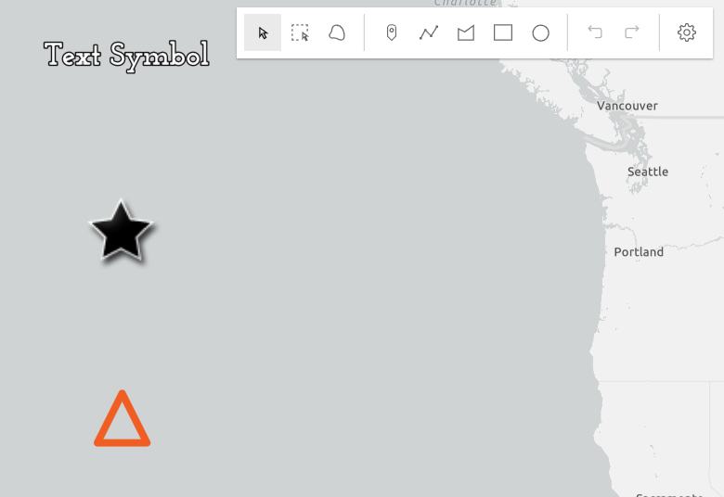
Selection & Highlight
Live Demo

Slide 21
Questions?

Slide 22




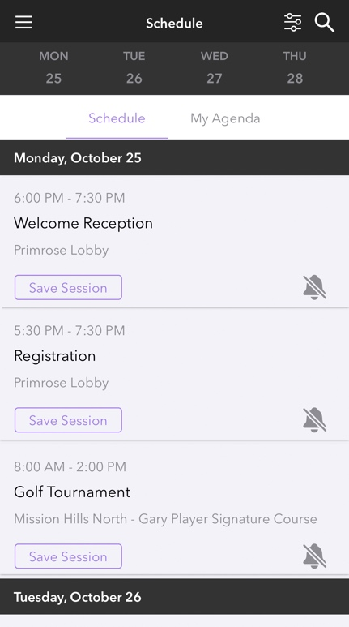

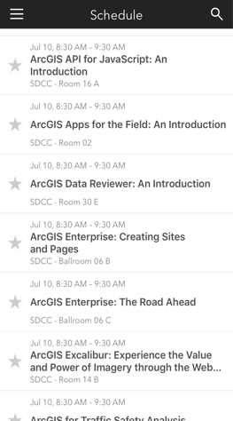
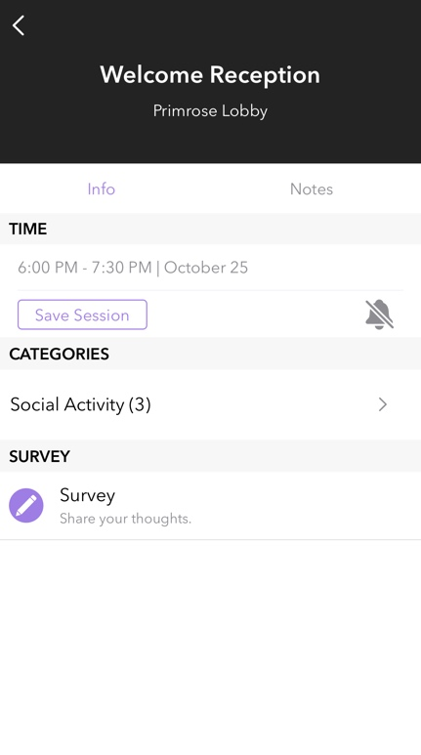

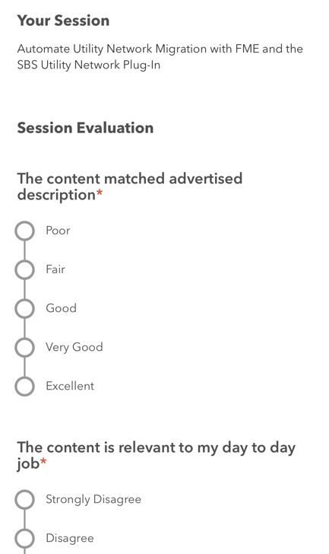
Please Share Your Feedback in the App
Download the Esri Events app and find your event
Select the session you attended
Scroll down to “Survey”
Log in to access the survey

Slide 23



Copyright © 2022 Esri. All rights reserved.

Slide 24
Presentation Title
Presenter Names
2022 ESRI DEVELOPER SUMMIT
Notes:
2022 Esri Developer Summit

Slide 25
Headline
Subhead
Bullets

Slide 26
Headline
Subhead
Bullets

Slide 27
Section Header
Section Subhead

Slide 28

Section Header
Section Subhead

Slide 29
Demo Title
Demo Presenter

Slide 30
Please Share Your Feedback in the App
Download the Esri Events app and find your event
Select the session you attended
Scroll down to “Survey”
Log in to access the survey

Slide 31
Copyright © 2022 Esri. All rights reserved.

